Slide 1
Customizing REST Payloads

Slide 2

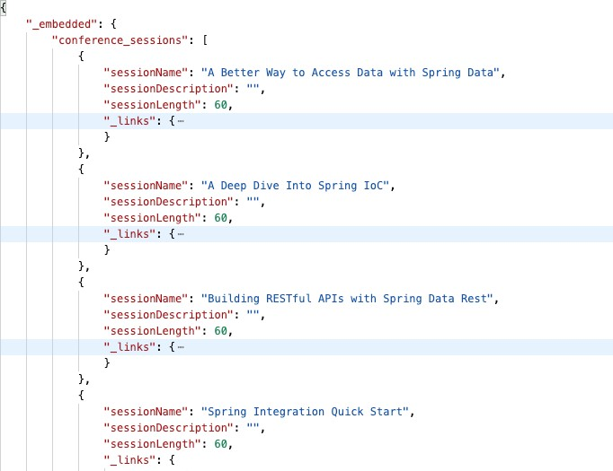


Changing Payloads with Projections

Slide 3



Creating a Projection
model or entity package
@Projection(name="sessionDetail", types = {Session.class}) public interface SessionDetail {
String getSessionName(); List<Speaker> getSpeakers();
}

Slide 4
Projections: Pros and Cons
Cons
Read only Clients can ignore them Not a service layer
Pros
Customizable payloads Buffers entity changes Minimal coding

Slide 5

Customizing Payloads with Jackson
Jackson JSON Parser
@Entity
public class User {
private String username;
@JsonIgnore
private String password;
}
https://github.com/FasterXML/jackson

Slide 6

Summary
Projections
Virtual projections Excerpts
Projection pros and cons Jackson JSON library

